Slide 1
Building fire monitoring

Slide 2
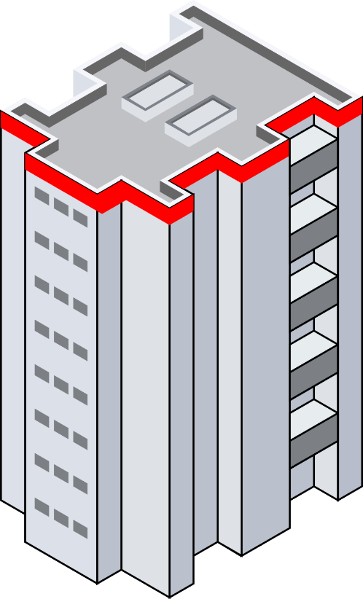



1
2
3
Unicast, src = 1, dst = 2, dir = left, dist = rc, left ids = 0

Slide 3
1
2
3
Unicast, src = 2, dst = 3, dir = straight line, dist = rc

Slide 4



2
Unicast, src = 2, dst = 1, not reached
2
1
3
3

Slide 5
2
Unicast, src = 1, dst = 2, ok
2
1
3
3

Slide 6
2
Unicast, src = 2, dst = 1, reached
3
1
4

Slide 7
2
Unicast, src = 1, dst = 2, ok
3
1
4

Slide 8
2
broadcast, status
3
1
4

Slide 9
2
1
3
4
Unicast, src = 1, dst = 3, dir = right, dist = rc, right ids = 0

Slide 10
2
1
3
4
Unicast, src = 3, dst = 4, dir = straight line, dist = rc

Slide 11

2
1
3
Unicast, src = 3, dst = 1, not reached
4
4
3

Slide 12
2
1
3
Unicast, src = 1, dst = 3, ok
4
4
3

Slide 13
2
1
4
5
Unicast, src = 3, dst = 1, reached
3

Slide 14
2
1
4
5
Unicast, src = 1, dst = 3, ok
3

Slide 15
2
1
4
broadcast, status
5
3

Slide 16
2
1
4
5
Unicast, src = 1, dst = 4, dir = left, dist = rc, left ids = 2
3

Slide 17
2
1
4
5
Unicast, src = 4, dst = 5, dir = straight line, dist = rc
3

Slide 18
2
4
1
5
5
4
3

Slide 19
2
4
1
unicast, src = 4, dst = 1, not reached
5
5
4
3

Slide 20
2
Unicast, src = 1, dst = 4, ok
4
1
5
5
4
3

Slide 21
unicast, src = 4, dst = 2, not reached
2
4
1
5
5
4
3

Slide 22
2
4
1
5
5
4
3

Slide 23
2
4
Unicast, src = 4, dst = 1, not reached
1
5
5
4
3

Slide 24
2
4
1
Unicast, src = 1, dst = 4, ok
5
5
4
3

Slide 25
2
4
Unicast, src = 4, dst = 2, not reached
1
5
5
4
3

Slide 26
Unicast, src = 2, dst = 4, ok
2
4
1
5
5
4
3

Slide 27

4
2
4
1
6
5
3

Slide 28
4
2
Unicast, src = 4, dst = 1, not reached
4
1
6
5
3

Slide 29
4
2
unicast, src = 4, dst = 2, not reached
4
1
6
5
3

Slide 30
4
2
Unicast, src = 2, dst = 4, ok
4
1
6
5
3

Slide 31
unicast, src = 4, dst = 2, reached
4
2
1
6
5
3

Slide 32
Unicast, src = 2, dst = 4, ok
4
2
1
6
5
3

Slide 33
4
2
Broadcast Status
1
6
5
3

Slide 34
4
2
Unicast, src = 2, dst = 1, id 4 reached
6
1
5
3

Slide 35
4
2
1
5
6
Unicast, src = 1, dst = 5, dir = right, dist = rc, right ids = 3
3

Slide 36
4
2
1
5
6
Unicast, src = 5, dst = 6, dir = straight line, dist = rc
3

Slide 37

4
2
1
5
6
6
3
5

Slide 38
2
1
5
6
Unicast, src = 5, dst = 1, not reached
6
3
5

Slide 39
4
2
1
5
6
6
Unicast, src = 1, dst = 5, ok
3
5

Slide 40
2
1
5
6
6
Unicast, src = 5, dst = 3, not reached
3
5

Slide 41

4
2
1
5
6
6
3
5

Slide 42
4
2
1
5
Unicast, src = 5, dst = 1, not reached
6
6
3
5

Slide 43
4
2
1
5
6
Unicast, src = 1, dst = 5, ok
6
3
5

Slide 44
4
2
1
5
Unicast, src = 5, dst = 3, not reached
6
6
3
5

Slide 45
4
2
1
5
6
6
Unicast, src = 3, dst = 5, ok
3
5

Slide 46

4
2
1
6
7
3
5
5

Slide 47
4
2
1
6
7
3
5
unicast, src = 5, dst = 1, not reached
5

Slide 48
4
2
1
6
7
3
5
unicast, src = 5, dst = 3 not reached
5

Slide 49
4
2
1
6
7
3
5
Unicast, src = 3, dst = 5, ok
5

Slide 50
2
1
6
7
3
5
unicast, src = 5, dst = 3, reached

Slide 51
4
2
1
6
7
5
3
Unicast, src = 3, dst = 5, ok

Slide 52
4
2
1
6
7
5
3
Broadcast Status

Slide 53
4
2
1
6
7
Unicast, src =3, dst = 1, id 5 reached
5
3

Slide 54
4
2
6
1
7
Broadcast Status
5
3

Slide 55
4
2
Received (id%2) != 0
6
1
7
5
3

Slide 56
4
Unicast, src=6, dst=4, boundary enclosed
2
6
1
7
5
3

Slide 57
Unicast, src=4, dst=2, boundary enclosed
4
2
6
1
7
5
3

Slide 58
4
2
6
Unicast, src=4, dst=2, boundary enclosed
7
1
5
3

